Slide 1

A’s Squad
Team Members-
1.aditi
2.akansha chaurasia
3.anoma singh
4.anshika agarwal

Slide 2

Problem Statement-
Build an Inventory Management System for the IGDTUW Canteen..

Slide 3
ARCHITECTURE
LOGIN PAGE
REGISTER
MENU AND BILLING SYSTEM
MENU
CUSTOMER MANAGEMENT SYSTEM
LOGIN
FORGOT USERNAME OR PASSWORD
CHOICES
QUANTITY
YOUR CHOICES
TOTAL PRICE
TOTAL AMOUNT TO BE PAID
AMOUNT PAID BY CUSTOMER
CHANGE
ADD
REMOVE
DISPLAY CUSTOMER LIST
INVENTORY MANAGEMENT SYSTEM
INSERT
DELETE
SEARCH
UPDATE

Slide 4
Results of Test Cases
USER AUTHENTICATION
ITEMS FOR PURCHASE ORDER AND MANAGEMENT
CUSTOMER MANAGEMENT SYSTEM
CANTEEN INVENTORY MANAGEMENT

Slide 5
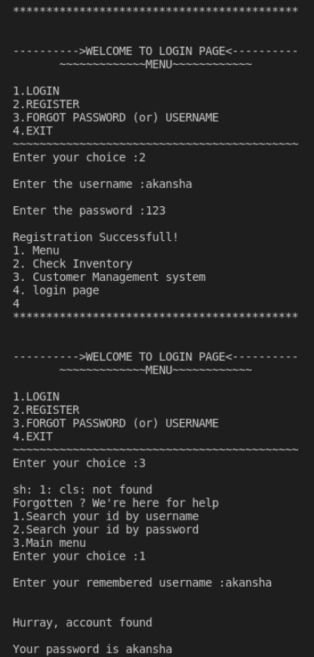
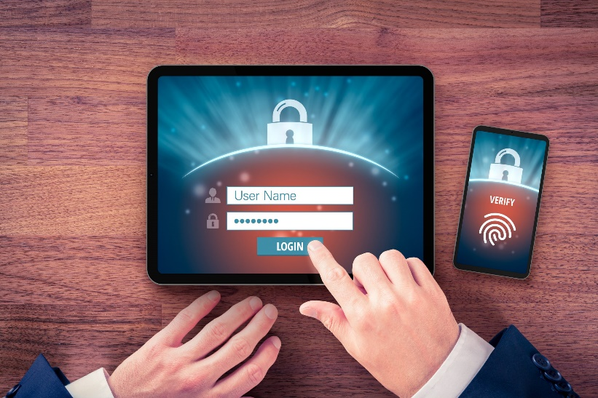
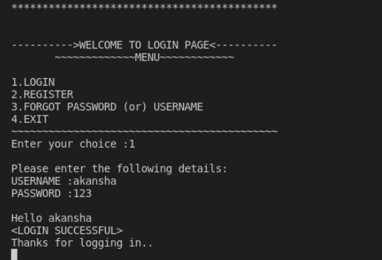
USER AUTHENTICATION
User first have to register herself / himself to log in to the website.
Then login in the system.
If the user forgets his/her password or username he/she can search his/her account by the forgot username and password option in the login page.

Slide 6
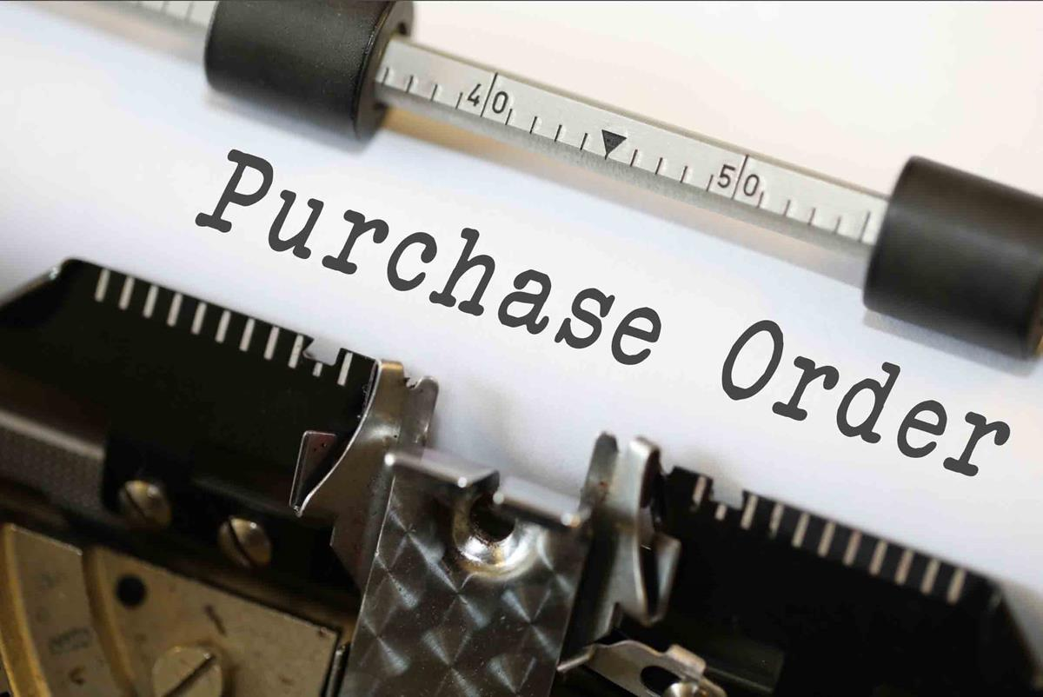
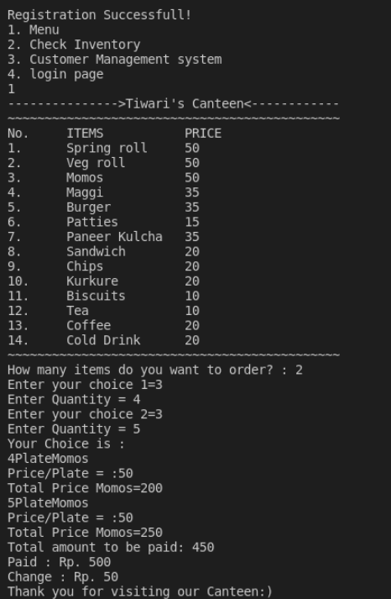
Items for purchase order and management
Here the user can order his/her desired number of items.
The user gets to know the price of each item and the total amount to be paid.
The system also indicates the amount paid by the customer and change to be returned to the customer.

Slide 7


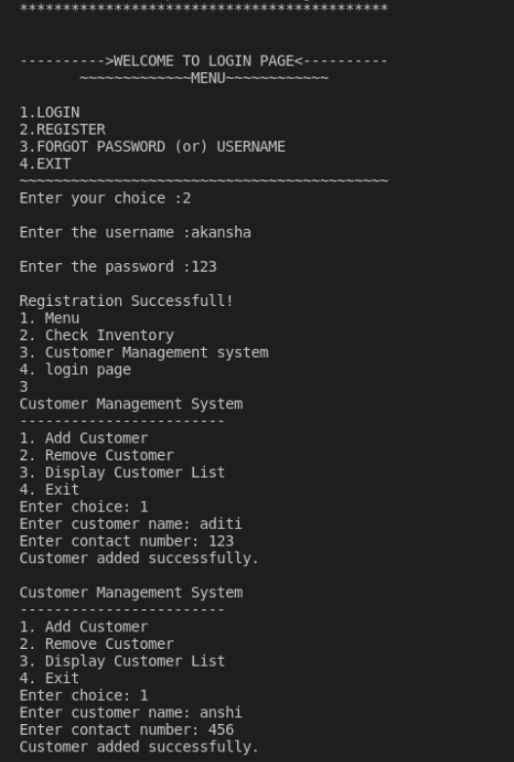
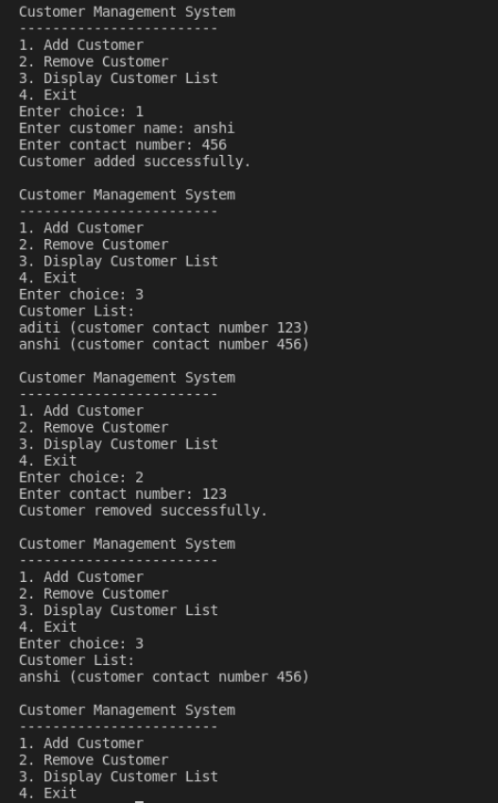
CUSTOMER MANAGEMENT SYSTEM
With this system Tiwari uncle can keep a track of his customers and there details by adding or removing them from the database.

Slide 8
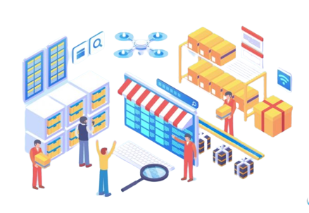
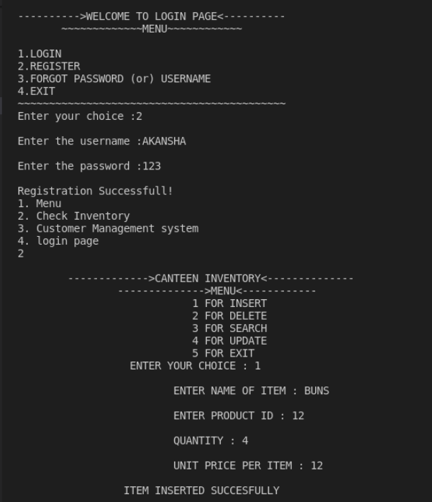
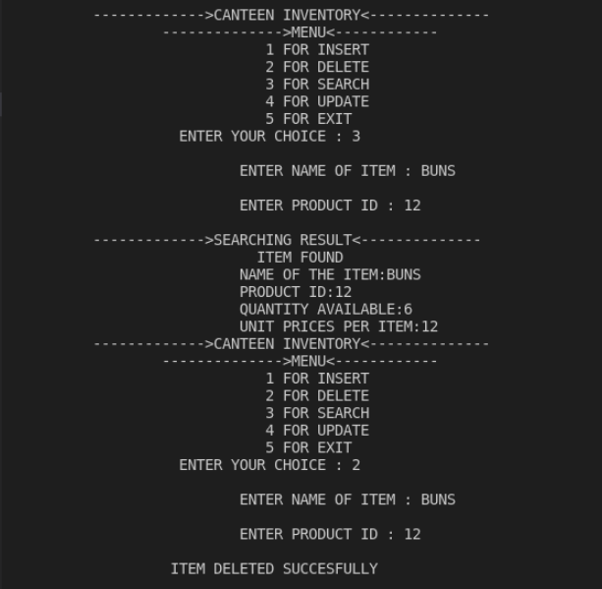
CANTEEN INVENTORY MANAGEMENT
Here Tiwari uncle can insert and delete the available/remaining stock.
He can also search for any of the item in his stock.
Hence, he will be able to manage his canteen inventory more efficiently.

Slide 9

REVENUE GENERATION/BUSINESS PLAN
There are several revenue models that this canteen management system can adopt. Here are a few examples:
Subscription model: In this model, customers pay a recurring fee to use this canteen management system. This could be based on the number of users or the number of transactions.
Commission-based model: In this model, the canteen management system takes a commission on each transaction that takes place through the system. This model is common in online food ordering platforms.
Advertising model: The canteen management system can sell advertising space on its platform to food and beverage companies, enabling them to promote their products directly to customers.
Transaction fee model: In this model, the canteen management system charges a small fee for each transaction that takes place through the system. This could be a fixed amount or a percentage of the transaction value.
SaaS model: In this model, the canteen management system charges a monthly or annual fee for access to the
platform, which is hosted and maintained by the provider.
Ultimately, the revenue model of a canteen management system will depend on the specific
needs of the business and its customers. It's important to consider factors such as
pricing, value proposition, and competition when deciding on a revenue model.

Slide 10

FUTURE SCOPE
This canteen management system has a wide range of applications and possibilities for future development. Here are some potential future scopes for a canteen management system.
Integration with payment gateways: This canteen management system can be integrated with payment gateways to enable online payment options. This can help in reducing the need for cash transactions, thereby making the system more secure and efficient.
Integration with loyalty programs: This canteen management system can be integrated with loyalty programs to incentivize customers to purchase more frequently, and to encourage repeat business.
Mobile app integration: A mobile app can be developed to complement this canteen management system, allowing customers to place orders, pay for purchases, and receive notifications about promotions and discounts.
Integration with health and nutrition tracking: The canteen management system can be integrated with health and nutrition tracking tools to provide customers with information about the nutritional value of the food they are consuming.
Integration with facial recognition technology: The canteen management system can be integrated with facial recognition technology to enable faster and more secure transactions, as well as to help prevent fraud . Overall, the future scope of this canteen management system is vast, and there are many opportunities for innovation and improvement in this area.

Slide 11
NOTE FOR TEAM EQUINOX AT CELESTIAL BISCUITS
We had enjoyed a lot in this hackathon by coding and thinking with team .. We learned a plenty of new things , and the mentorship sessions during the hackathon were very helpful. We are very thankful to all the mentors who helped us during the hackathon period..
*Special thanks to Pooja di and Aryan Kaushik sir for resolving our doubts even in the midnight..*

